Slide 1
Real-time Analytics Dashboard for SwiftKart
By
Team Analysts

Slide 2
Executive Summary
Problem Statement : SwiftKart confronts issues with dark store optimization and delivery management, resulting in high operational expenses and unpredictable customer satisfaction.
Solution: A real-time analytics dashboard that delivers actionable data on critical operational parameters.
Objective:
Identify operational bottlenecks and inefficiencies.
Increase delivery performance and client satisfaction.
Optimize inventory management and cut expenditures.
Support data-driven decision-making for strategic expansion.

Slide 3
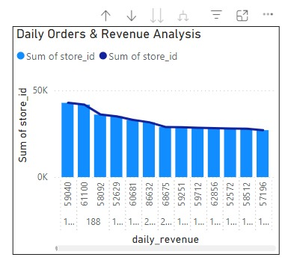
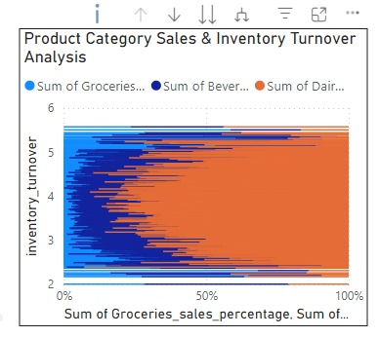
Dashboard Overview Key Metrics Analysis-1
Daily Orders & Revenue Analysis: Analyzing Daily Order Volume (DOV) and Daily Revenue to understand sales performance.
Product Category Sales & Inventory Turnover Analysis: Analyzing the sales performance of different product categories to understand how quickly inventory is sold and replaced.

Slide 4
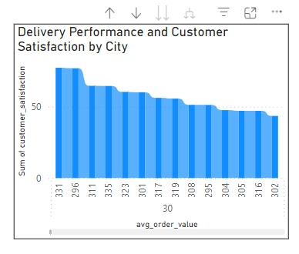
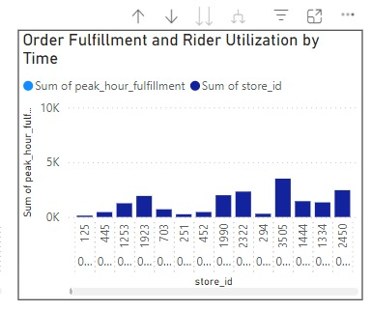
Dashboard Overview Key Metrics Analysis-2
Order Fulfillment and Rider Utilization by Time: Examine how efficiently orders are fulfilled during peak hours and how well riders are utilized. help identify bottlenecks, optimize delivery schedules, and improve overall delivery efficiency.
Delivery Performance and Customer Satisfaction by City: examining factors like average delivery time and customer feedback, we can identify areas for improvement and optimize delivery operations to enhance customer experience.

Slide 5
Implementation Guide
Data Source: Central Database (CSV format)
Dashboard Tool: (Specify the tool used, e.g., Tableau, Power BI, Looker)
Data Pipeline:
Data Extraction: Extract relevant data from the central database.
Data Cleaning and Transformation: Clean the data to ensure accuracy and consistency.
Data Loading: Load the cleaned data into the dashboard tool.
Dashboard Development:
Create Data Visualizations: Create visualizations for each key metric using appropriate chart types (e.g., bar charts, line charts, pie charts).
Set Up Real-time Updates: Configure the dashboard to automatically refresh and update with the latest data.
Add Filters and Drill-Downs: Implement filters and drill-down capabilities to allow users to explore data at different levels of detail.

Slide 6
Dashboard Deployment:
Publish the Dashboard: Deploy the dashboard to a web server or cloud platform for easy access.
Grant Access: Control access to the dashboard based on user roles and permissions.
Maintenance and Support:
Monitor Data Quality: Regularly monitor the data quality and update the dashboard as needed.
Provide User Training: Train users on how to use the dashboard effectively.
Address Issues and Feedback: Respond to user feedback and resolve any issues promptly.

Slide 7
Benefits and Next Steps
Benefits:
Improved operational efficiency
Enhanced decision-making
Increased customer satisfaction
Reduced costs
Next Steps:
Expand the dashboard to include additional metrics and analyses.
Integrate the dashboard with other systems (e.g., inventory management, delivery management).
Develop predictive models to forecast future trends and optimize operations.

Slide 8
Additional Considerations:
Data Security: Implement robust data security measures to protect sensitive information.
User Accessibility: Design the dashboard to be user-friendly and accessible to users with different levels of technical expertise.
Collaboration: Foster collaboration between different teams (e.g., operations, marketing, finance) to leverage the insights from the dashboard.
By implementing this real-time analytics dashboard, SwiftKart can optimize its operations, improve customer satisfaction, and achieve sustainable growth.

Slide 9
Dashboard
https://app.powerbi.com/view?r=eyJrIjoiNDQ5ZmFjYjctNWJkOC00YTYxLTg2N2EtZGQwMmIyYTI5M2JjIiwidCI6IjhhZDE4ZGEwLWQ5YjUtNGFmYy04ZGM3LTBmMTY5MzgxOWFjMiJ9

